Slide 1
Missing info
About
communicate a brand story
content and layout
News
news articles
article page wire frame
Jobs
job search
job search wire frame (not same as company page)
Companies
company search
company page wire frame
Advertise
contact info for advertising
contact info for advertising

Slide 2

Home page
Wait for Chealy’s draft first

Slide 3
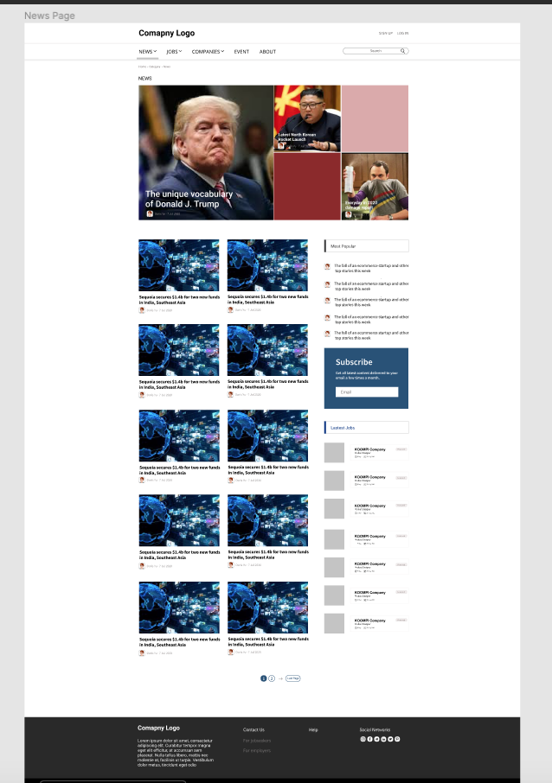
News
Infinite scroll down, so users don’t have to click next page

Slide 4
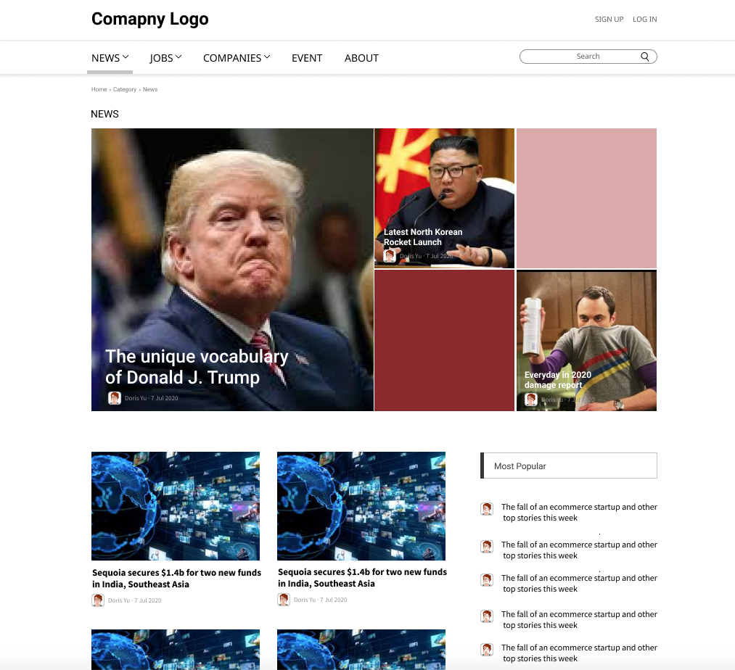
News
News
Top stories
Cambodia
International
Mobile
E-commerce
Fin-tech
Ed-tech
Startups
Founders
Investment
Opinions
Talents
Recruitment
Resources
Partnership
no drop-down
no drop-down

Slide 5
News
Articles
missing page, please help create

Slide 6
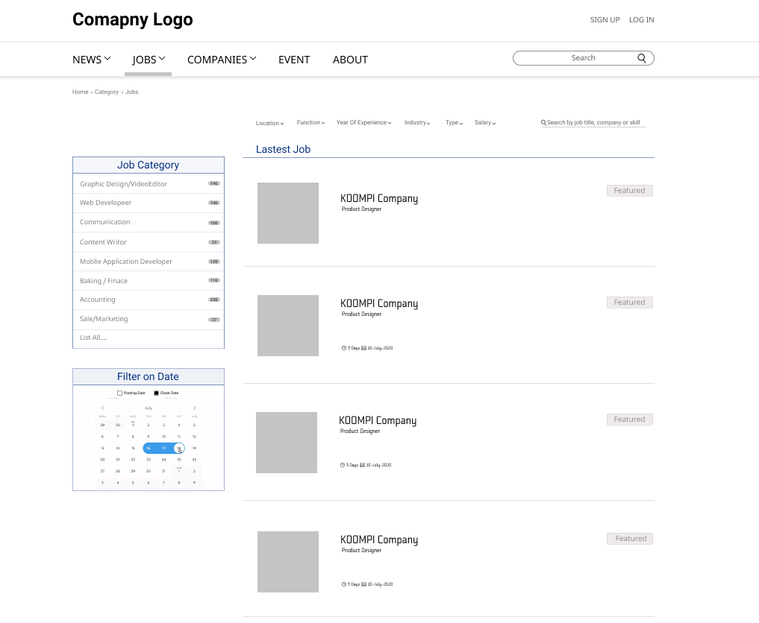

Jobs
Job function
Location
Salary range
Job type (full time, internship…)

Slide 7
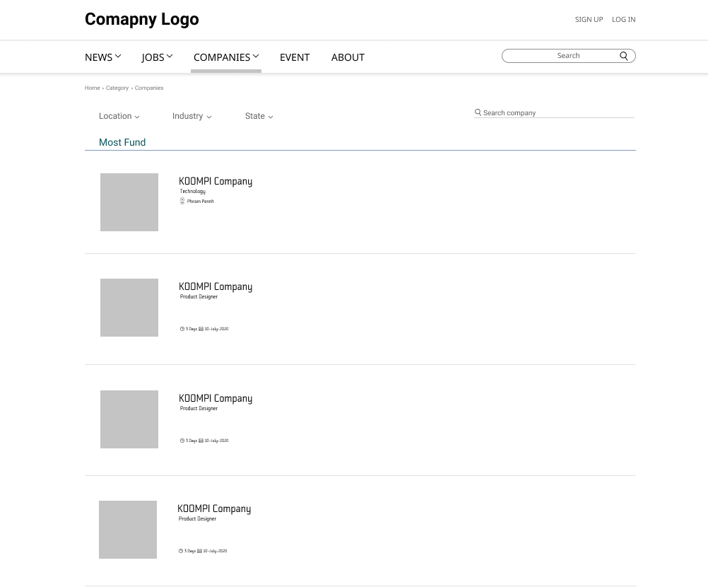

Companies
Can remove due to limited resources
Location
Sector
No. staff

Slide 8
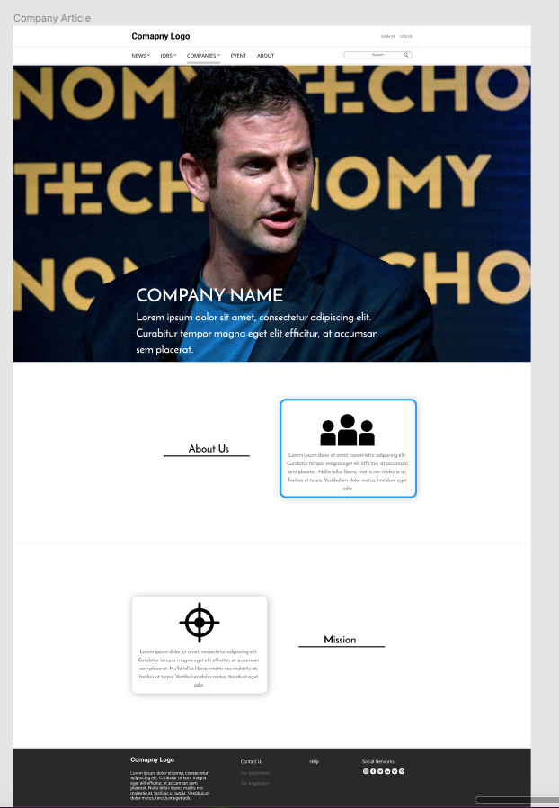
Companies
Missing features:
Links to official web and social media
No. of staff
Sector
Location

Slide 9
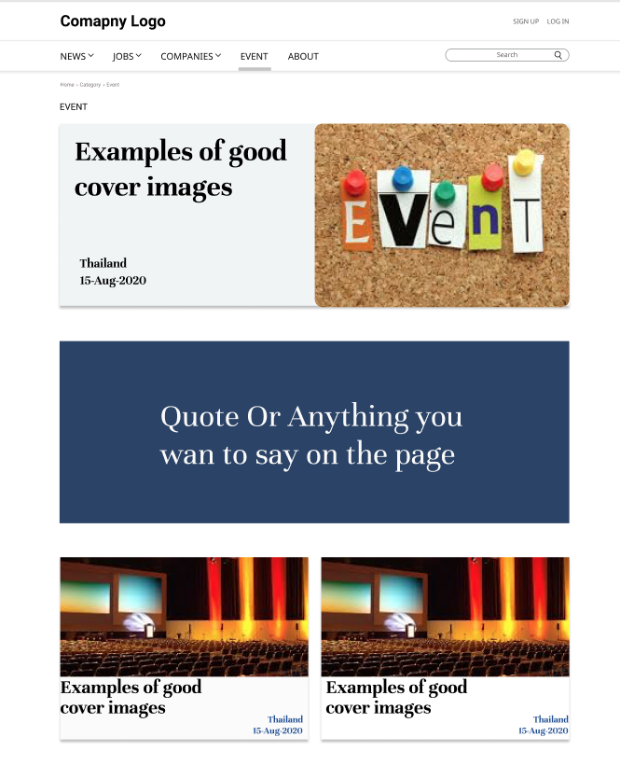
Events
Event details land on Everbrite/external social media page

